Slide 1
Warm Up
[Muhammad] said, “…fight everyone in the way of God and kill those who disbelieve in God…”
How can a religion who speaks of peace have a prophet who claims they should kill those who do not believe in their God? Can these two things co-exist within a religion or is one more true than the other?

Slide 2
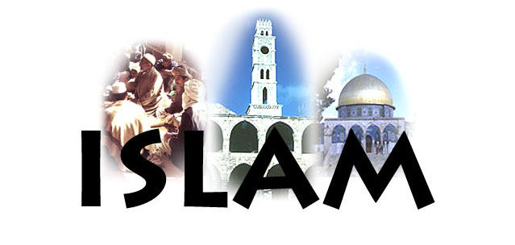

Slide 3
Islam
In A.D. 622, a new religion called Islam arose in Arabia
Like Christians and Jews, people who follow Islam believe in one God – monotheism
**Muslims are the people
Islam is the religion**

Slide 4
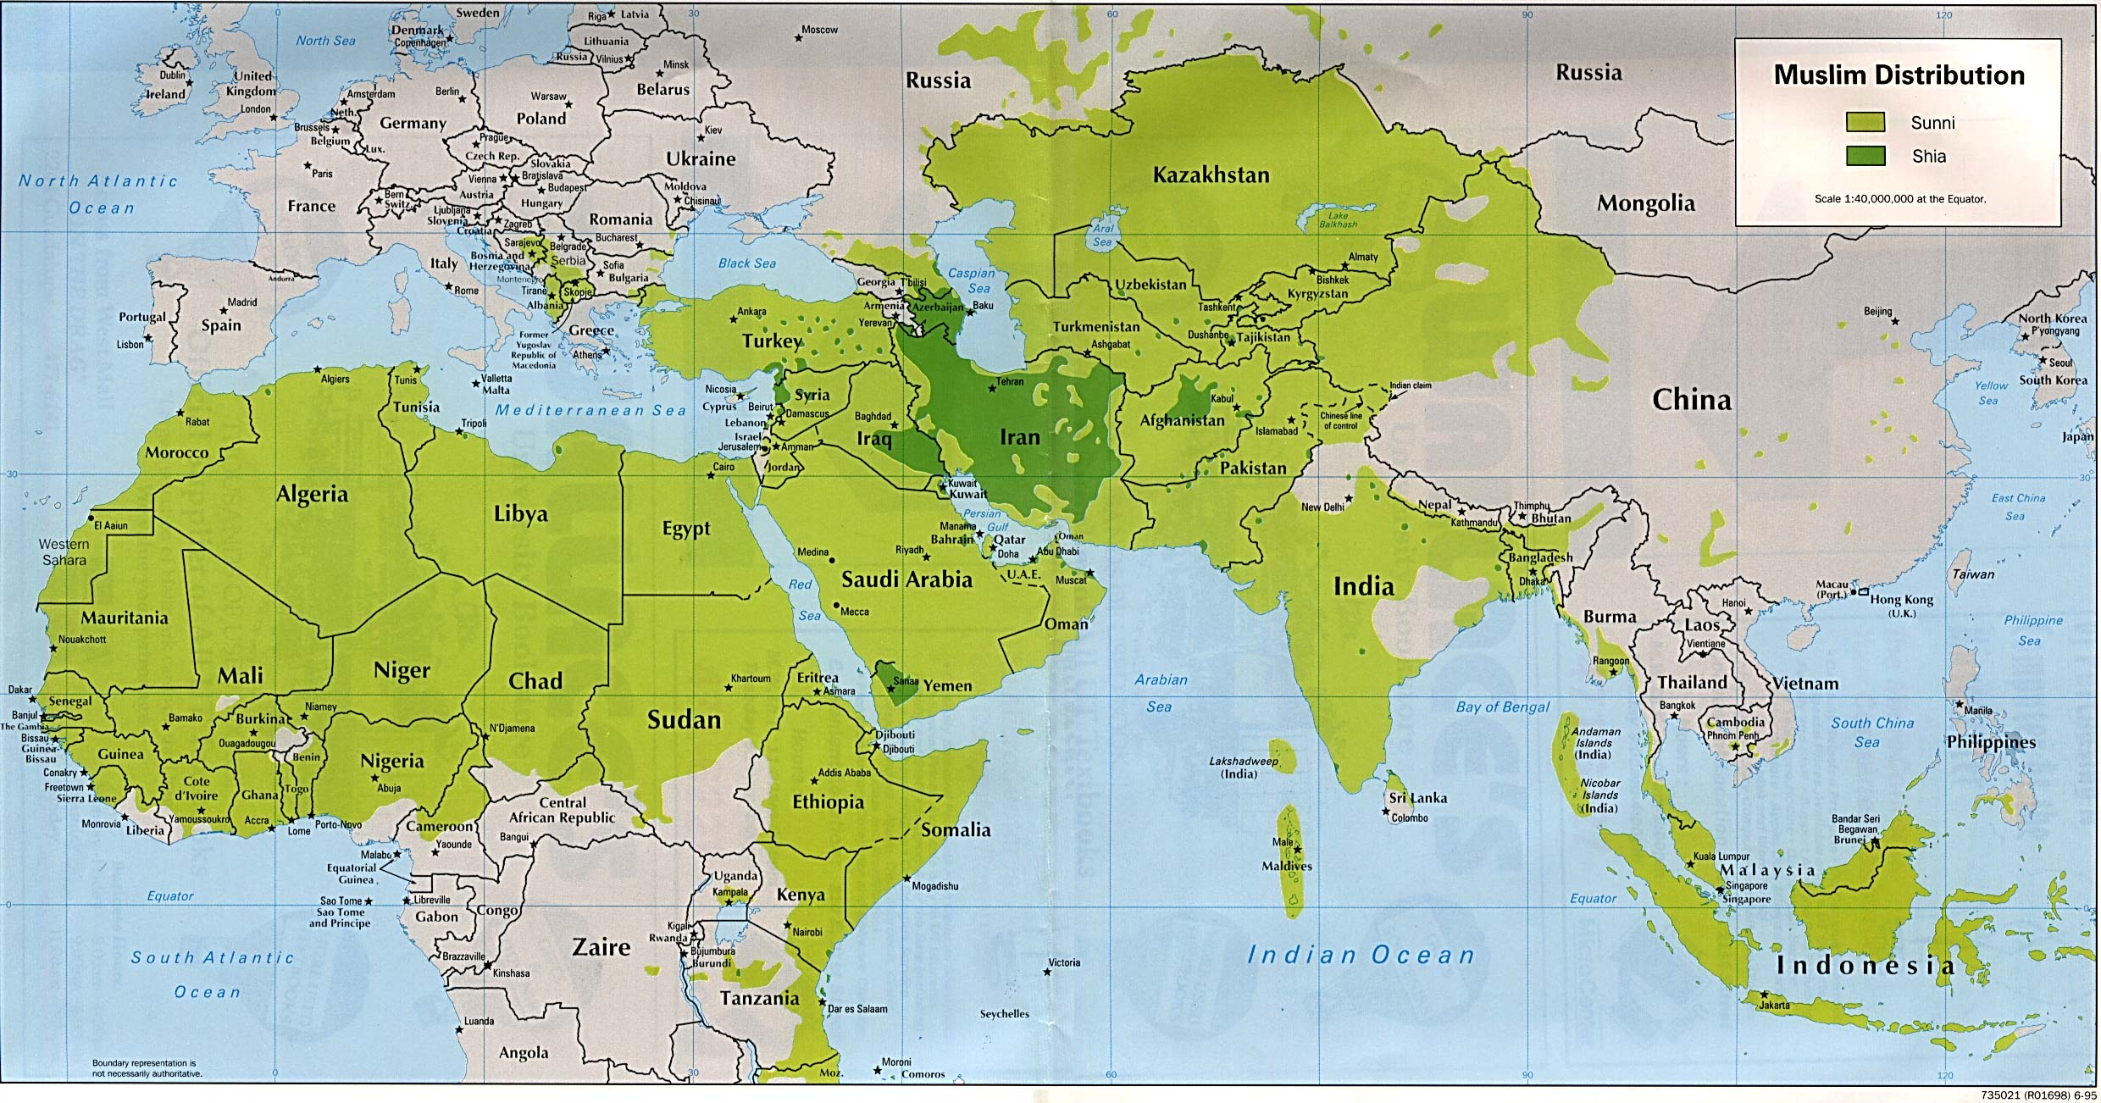
The Muslim World

Slide 5
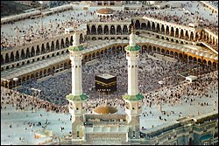
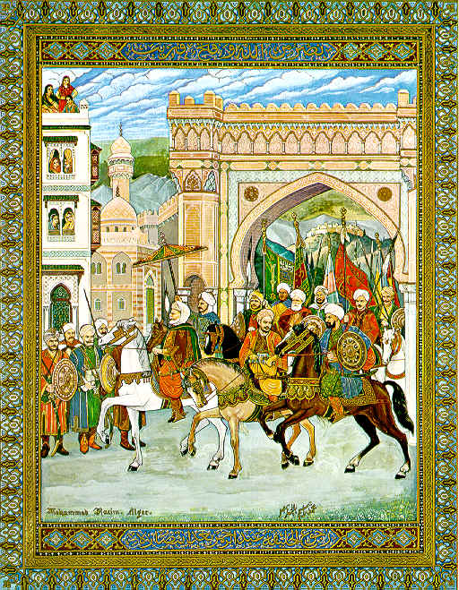
Islam Spreads
In the 150 years after the death of Muhammad, Islam spread rapidly over three continents (Asia, Africa, Europe); overcoming geographic barriers and weakened political empires.
Skillful Arab fighters spread Islam through military conquest
Because the Arabs treated conquered peoples in a fair way, many people converted to Islam willingly
The teaching of Islam appealed to many because it emphasized honesty, generosity, and social justice

Slide 6
Spread of Islam
Trade had always been considered an honorable occupation for Muslims
Muslims built vast building empires
Merchants established trading networks with Africa, China, and India
In India, Muslim traders were an important means of spreading Islam
At the other end of the Eurasian landmass, Islam spread from North Africa into Spain
Islamic traditions and customs developed over centuries and created a distinct Muslim culture.

Slide 7
Spread of Islam..
Diffusion along trade routes from Mecca and Medina
Expansion despite great distances, desert environments, and mountain barriers
Spread into the Fertile Crescent, Iran, and Central Asia, facilitated by weak Byzantine and Persian empires.
Political unity and the Arabic language facilitated trade and stimulated intellectual activity.
In the early Islamic lands:
Political unity of the first Muslim empire was short-lived.
Arabic language spread with Islam and facilitated trade across Islamic lands.
Slavery was not based on race.

Slide 8
Islam after Muhammad: Caliphs
After Muhammad died, various family members and friends took turns ruling
They were known as caliphs (deputies). They didn’t claim to be prophets (like Muhammad), they just led the people.
As a group, the caliphs were known as the Rashidun (rightly guided caliphs).

Slide 9
The Caliphs
Abu Baker = first caliph. Restored peace after Muhammad died. Started to compile the verses for the Quran. Muhammad’s father-in-law.
Umar= Friend of Muhammad who was the 2nd caliph. Spread Islam into Egypt. Helped the poor.
Uthman = son-in-law. Distributed text of the Quran.
Ali = son-in-law/ cousin. Reformed taxes.
*The last 3 Caliphs were murdered.

Slide 10
Turning Points in Islam:
Death of Ali: Sunni- Shi’a Split- 661
-After Ali was assassinated, some believed only his descendants should rule; they are known as the Shia/ Shiite.
-Others thought that following the way of Muhammad and being from his clan were enough; they are known as the Sunna/ Sunni Muslims.
-Even though there was conflict, Muslims refused to fight other Muslims. So, there was no war over this; just a separation
-The Sunnis make up the majority of Muslims.

Slide 11
Turning Points in Islam:
2. Muslim conquest of Damascus and Jerusalem- 635 and 637
Conquered Damascus; took it from the Byzantines after a siege and battles
After a 4-month siege, the residents of Jerusalem surrendered the city to the Muslims. Within a year, all of Palestine was under Muslim control.

Slide 12
Turning Points in Islam:
3. Muslim defeat at the Battle of Tours – 732
- Muslims were defeated by the French King Charles Martel.
-Because of this defeat, Muslims were pushed back into Spain, where they remained in power for another 700 years.
-They advanced no further into Europe

Slide 13
Turning Points in Islam:
4. Islamic Capital moved to Baghdad -762
5. Fall of Baghdad to Mongols -1258

Slide 14
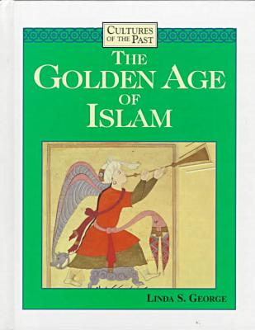
Golden Age Contributions
During the Abbasid golden age, Muslim cities became great cultural centers where enormous advances were made in literature, art, science, and medicine.

Slide 15
Contributions of Islam:
Architecture:
Mosques: Domes, Minarets
Dome of the Rock: where Muhammad left for Heaven. Located in Jerusalem.
Art:
Mosaics
Calligraphy
Geometric designs
Arabic alphabet and language

Slide 16
Contributions of Islam:
Universities:
Cordoba, Spain and Baghdad
Preserved Greek, Roman, Indian & Persian learning
Linked by trade throughout the empire
Translated ancient texts into Arabic
Helped with the rebirth of knowledge in the Renaissance
Literature:
A Thousand and One Arabian Nights (unknown),
The Rubiyat (by Omar Khayyam)

Slide 17
Contributions of Islam:
Scientific:
Arabic numerals and concept of zero (India)
Algebra (Al Jabr)
Medicine:
Established hospitals and schools
Blended Asian and European knowledge
Expansion of Geographic knowledge:
Improved ships, perfected the astrolabe, made wide use of the compass, made the Age of Exploration and Discovery possible

Slide 18
Important Events in Islamic History:
570 AD Mohammed is born.
613 Mohammed begins preaching in Mecca.
622 Hijrah (Hegira) to Medina (Yathrib) takes place.
630 Prophet (Mohammed) returns to Mecca.
632 Mohammed dies and his teachings are collected and recorded in the Qu’ran (Koran).
632-661 Four Rightly Guided Caliphs rule and continue expansion of Islamic empire.
661-750 Umayyad Dynasty rules; capital is moved to Damascus.
690 Dome of the Rock becomes an important monument.
711 Muslims invade Spain.
732 Muslims advance into western Europe; they are halted at the Battle of Tours.
750 Abbasid Dynasty begins (and lasts until 1255).
762 Capital moves to Baghdad.
1258 Mongols pounce on Baghdad, kill the last Abbasid ruler, and destroy the city.

