Slide 1
Bellwork Nov. 28, 2016
We have been talking about Greek Philosophy and thought for a great deal of time lately. Please think through and write an account of where we are in history at this time. What is the status of Greece? Who is in power? Where does Athens fit in this? Who will be rising to power?
Also, please make sure you have room in your binder for our new readings.

Slide 2
Macedonian Hegemony (346 B.C.)
Rise of Phillip II
  Macedonia gains influence over Greece.
  Phillip II, king of Macedonia is encouraged to unite all of Greece under his rule as King.
  Isocrates (“They Speak nothing of your Power”)
    Isocrates, a former Athenian citizen, writes to Phillip encouraging him to form a league under his control and unite Greece for two purposes:
      Stop the wars between the City States: Harmony
      Conquer Persia
      Isocrates claims that Phillip II is the only one capable of doing this because he has Wealth and Power, which are the two things that can both Persuade and Compel.

Slide 3
Macedonian Hegemony cont.
  Demosthenes (The Phillipics 351 B.C.)
    Not everyone agreed with Phillip being the one to rise to power.
    Demosthenes, an Athenian as well, called his people to remember the greatness of Athens. He wanted them to rise up to meet this “foe” and prove to the rest of Greece that Athens was still the greatest power in all of Greece.
    He helped lead his people to fight against Phillip and Macedonia. They were easily crushed.
    However, his rousing speeches did call for the greatness of the democratic system, the call to remember their ancestors, as well as the need for a free people to fight when they are against a dictator.

Slide 4
Macedonian Hegemony cont.
  The Corinthian League (338 B.C.)
    After defeating the Athenian uprising, Phillip calls together all of the Greece city-states. (the only one truly forced to be there was Athens)
    Sparta was the only other city-state to decline the offer, and Phillip wisely did not demand their presence.
    This League was much more orderly than Demosthenes claimed it would be. Most Greeks were happy with the purposes of the League that Isocrates put forth. However, they did lose their Independence. They were now Greece. (except Sparta)

Slide 5
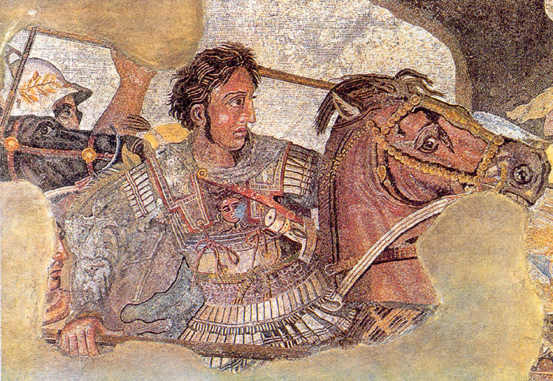
336-323 Reign of Alexander the Great

Slide 6
336-323 Reign of Alexander the Great
Son of Philip II of Macedon
  Phillip had received only a military and diplomatic education
  He had only conquered a small amount of territory (Greece)
Tutored by Aristotle in philosophy, history, and literature until the age of 16

Slide 7
336-323 Reign of Alexander the Great
By age 30, he had created one of the largest empires of the ancient world
  From Greece to modern-day Iran
  Undefeated in battle

Slide 8
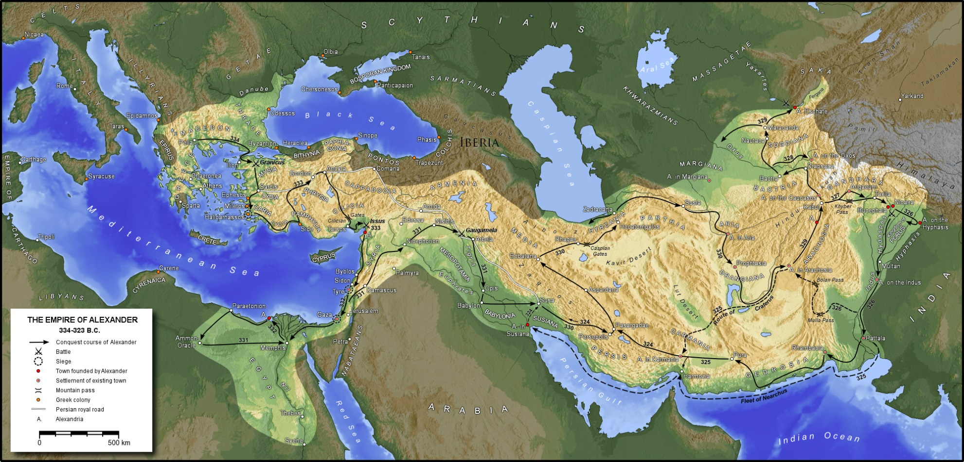

Slide 9
336-323 Reign of Alexander the Great
Failures of Alexander
  Tried to invade India, but his men convinced him he had to turn back because so many of them were getting sick
  As soon as he died, his empire was torn apart by civil wars
  His greatest flaw was his Pride.
    Arrogance lead to many of his issues both politically as well as personally.

Slide 10
336-323 Reign of Alexander the Great
Alexander’s legacy
  Founded twenty cities that bore his name, such as Alexandria in Egypt
  Settlement of Greek colonists and resulting spread of Greek culture in the east resulted in a new Hellenistic civilization, aspects of which were still evident in the traditions of the Byzantine Empire in the mid-15th century AD
  Became legendary as a classical hero in the mold of Achilles, features prominently in the history and myth of Greek and non-Greek cultures
  Became the measure against which military leaders compared themselves, and military academies throughout the world still teach his tactics

Slide 11
