Slide 1
335 Aristotle Returns from Macedon to Athens
Aristotle’s Doctrine of the Mean
Mean = average
Aristotle says that the right thing is always between two extremes
He also says that one develops good character by doing the right thing over and over until it is a habit

Slide 2
Aristotle’s Doctrine of the Mean
Western tradition has named seven virtues
Cardinal Virtues
Prudence
Justice
Temperance
Courage (or Fortitude)
Theological Virtues
Faith
Hope
Love (or Charity)

Slide 3
Cardinal Virtues
From Greek philosophers
Prudence - ability to judge between actions with regard to appropriate actions at a given time
Justice - the perpetual and constant will of rendering to each one his right
Temperance - practicing self-control, abstention, and moderation; tempering the appetite
Courage - forbearance, endurance, and ability to confront fear, uncertainty and intimidation

Slide 4
Theological virtues
From Christian doctrine
Faith - belief in God, and in the truth of His revelation, as well as obedience to Him
Hope - expectation of and desire of receiving; refraining from despair and capability of not giving up. The belief that God will and forever be eternally present in every human's life and never giving up on His love.
Love - a supernatural virtue that helps us love God and our neighbors, more than ourselves.

Slide 5
The virtues
By the end of the Roman Empire (400AD), the four Cardinal Virtues and the three Theological Virtues had been combined in almost everyone’s thinking as the seven parts of a good character.

Slide 6
Response Paragraph
Choose among the seven virtues which one you need to work on the most. Then,
Explain how the virtue you need to work on is the mean between two extremes.
Explain how you are going to work on cultivating that virtue in your life.

Slide 7
Wednesday/Thursday, Nov 13/14 Bellwork
Review pages 107-108. Did Aristotle’s student, Alexander, follow Aristotle’s Doctrine of the Mean?

Slide 8
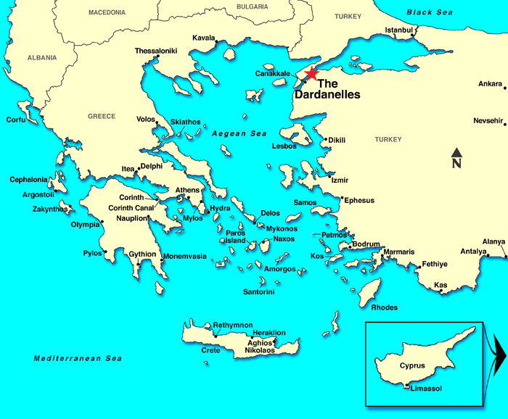
334 Alexander crosses the Dardanelles

Slide 9
334 Alexander crosses the Dardanelles
Now he is in Turkey
Wins a major victory near the Sea of Marmara
Accepts surrender of Sardis
Miletus defies him, he takes it by siege
Conquers and renames Alexandria Pisidia

Slide 10
333 Alexander moves in to Mesopotamia
Takes Tyre and Sidon, capitals of the Phoenicians
332 Takes Damascus, capital of Syrians
332 Takes Gaza

Slide 11
332 Alexander Marches into egypt
Founds Alexandria

Slide 12
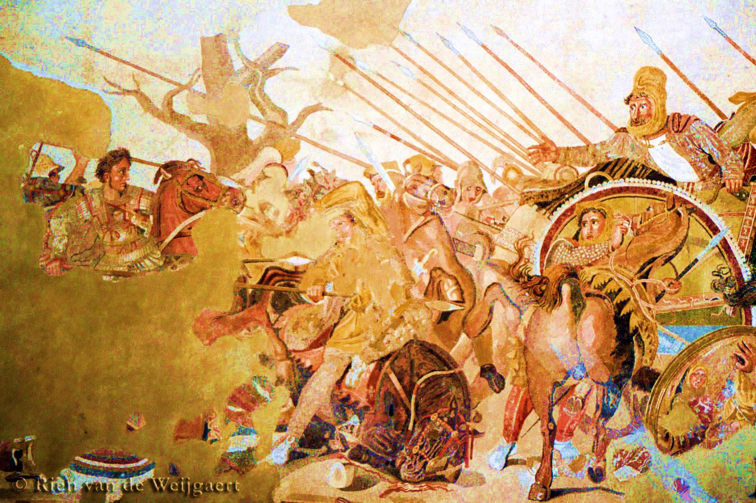
331 Battle of Gaugamela
Between Alexander and Darius III
Near Ninevah
Led to the fall of the Persian Empire
Persians use war elephants

Slide 13
330-325 Alexander in Persia and India
330 Alexander burns Xerxes I’s palace in Persepolis
327 Alexander invades northern India
327 Alexander executes his historian Callisthenes for treason
Callisthenes was Aristotle’s nephew
Aristotle is not happy with Alexander
326 Alexander founds two Alexandrias in northern India
on the Indus (Uch, Pakistan today)
Bucephalous (after his horse)

Slide 14
330-325 Alexander in Persia and India
Fun fact: 325BC – the first known reference to sugar cane appears in writings by Alexander the Great's admiral Nearchus, who writes of Indian reeds "that produce honey, although there are no bees"

Slide 15
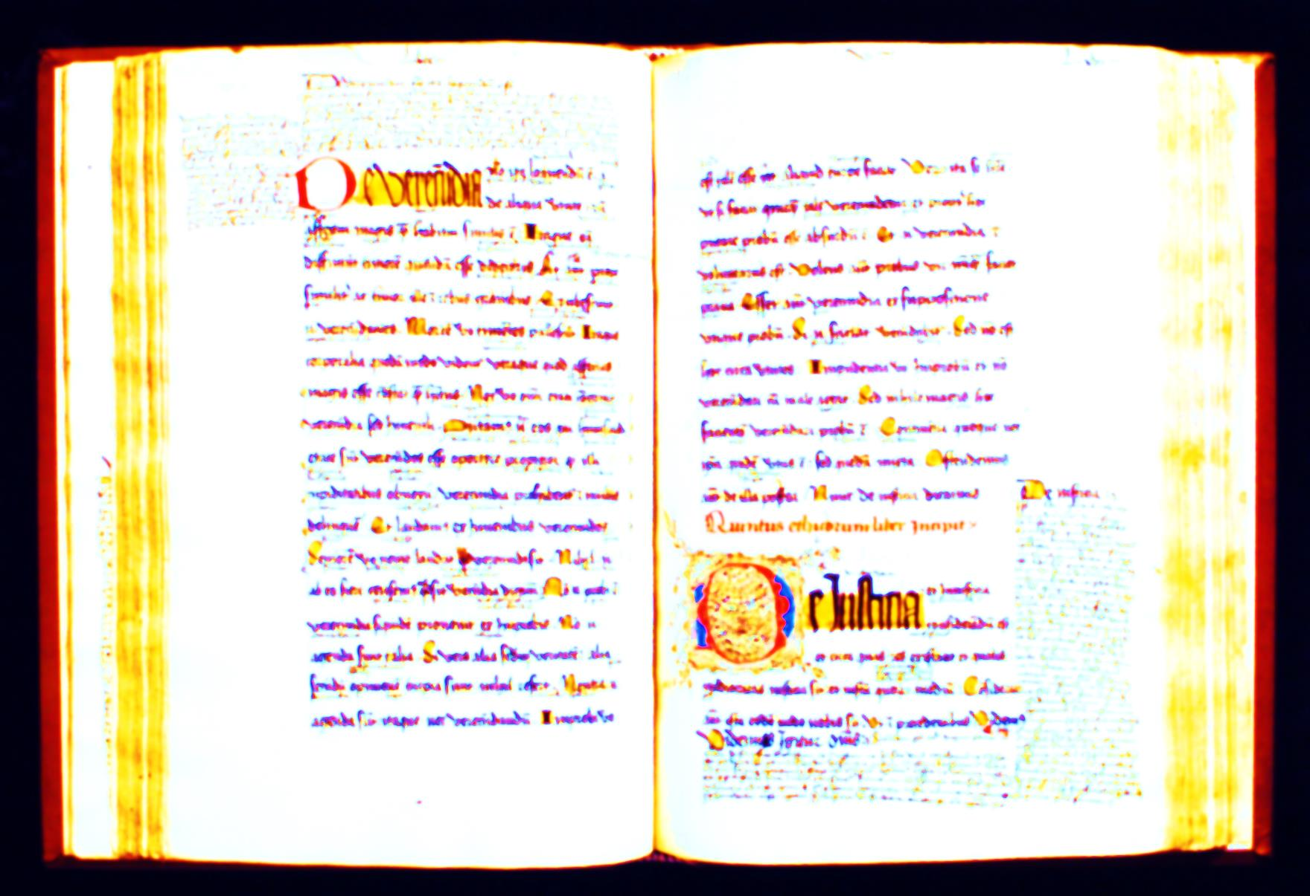
325 Aristotle writes Ethics
10 years after coming home from teaching Alexander
The year after Alexander conquers parts of India
He dies three years later

Slide 16
323 Alexander Dies
After a prolonged feast and drinking bout
Throughout his rule, he had killed whoever looked like they might come in his way, or anyone who stepped slightly out of line

Slide 17
323 Partition of Babylon
Remember that Alexander wanted to imitate the Old Babylonian Empire?
Well, the agreement that split up his empire after he died was appropriately named The Partition of Babylon

Slide 18
323 Partition of Babylon
Very, very complicated
The empire was immediately split about a hundred different ways by different generals and governors
But by about 305BC, four generals and their families controlled four main parts of the empire

Slide 19
323 Partition of Babylon
Antigonus
Antigonid Asia Minor and Northern Syria
Lasted until 168BC, when the Romans came through

Slide 20
323 Partition of Babylon
Lysimachus
Attalid Pergamon (Turkey)
Lasted until 133BC, when Lysimachus’ descendents bequeathed the empire to the Romans to avoid a succession controversy

Slide 21
323 Partition of Babylon
Seleucus
Seleucid Mesopotamia, Persia, India
Lasted until 63BC, when it fell to Rome
Fought over Jerusalem against the Ptolemies

Slide 22
323 Partition of Babylon
Ptolemy
Ptolemaic Egypt
Lasted until 30BC, when Cleopatra, descendent of Ptolemy and last pharaoh of Egypt, fell to Rome
Fought over Jerusalem against the Seleucids
Interesting note: there was a famous Roman philosopher and scientist who lived in Alexandria, Egypt from 90AD to 168AD named Ptolemy. It is not known whether he was related to Alexander’s Ptolemy of the 300sBC.

Slide 25
Fun Fact
318BC Aristoxenus, a Greek philosopher and pupil of Aristotle, writes a treatise on music called “The Elements of Harmony“
Survives only in fragments
Attempted a complete and systematic exposition of music
Divides music into seven parts: genre, intervals, sounds, systems, tones or modes, mutations, and melody

Slide 26
330-280 Wars between Romans and latins
Sicily and Carthage also fighting each other
Romans fighting Samnites, Tarentum, and Etruscans
Rome grows in power and land mass

Slide 27
340-273 Appius Claudius Caecus
Censor
Someone who keeps tabs on whether patricians are rich enough to stay in the patrician assembly
312 began construction on the Appian Way
One of the earliest and strategically most important Roman roads
Connected Rome to SE Italy
Lots of it still survives today!

Slide 31
340-273 Appius Claudius Caecus
Rome gets its first pure drinking water as engineers complete the first aqueduct into the city, the Aqua Appia
The Romans were the first to come up with a way of transporting drinking water over land
Called aqueducts = water tubes
Lots of these survive today!

Slide 34
Friday, November 15 Bellwork
Review your notes from Wednesday (1st Hour) or yesterday (6th Hour). Choose one thing we discussed in class and write a paragraph connecting that historical event to your life today.

Slide 35
Friday, Nov 15 Reading Guide Answers
The Romans achieved an unwritten constitution and the promotion of domestic reforms to assure political equality for all citizens without violence.
270BC
133BC
Augustus

Slide 36
Bellwork Discussion
Next time you eat something sugary (umm, like, today at lunch), you can awkwardly blurt out to the entire lunch table that you know when sugar cane was first mentioned in Western writing.
You can still visit cities Alexander conquered and renamed after himself!
You can still read a Classical Greek book that tells you helpful things such as “happiness is activity in accordance with virtue”!
You can learn from Alexander’s mistakes.
You can calmly explain to your poor, confused friends that Cleopatra was not Egyptian, but rather a Greek ruler descended from one of Alexander the Great’s generals.
You can still learn about music from a Hellenistic Greek philosopher!
You can still walk on roads the Romans built and see the ruts their chariot wheels made!
You can drive under Roman aqueducts!

Slide 37
307 Ptolemy founds museum and library at Alexandria, Egypt
Alexander had seen the library at Ninevah before he burned it (after the Battle of Gaugamela), and wanted to imitate it
Now his successor in Egypt does that for him in one of the cities named after him

Slide 41
Connection
Same year: Epicureanism founded in Athens by Epicurus.

Slide 42
283 Library Enlarged
Ptolemy II enlarges the library at Alexandria
Appoints grammarian Zenodotus to collect and edit all the Greek poets

Slide 43
287 new Roman law: Lex Hortensia
Much greater power to the Plebeian Assembly compared to the Senate
Passed following a threat from plebeian soldiers to secede (as usual)
Named after Quintus Hortensius, a plebeian, who is made dictator to settle the controversy
Note: dictator was an official position people were elected to if there was some emergency and the city needed one ruler, instead of the two consuls. The position of dictator was only supposed to last for six months.

Slide 44
286 new Roman law: Lex Aquilia
Provides compensation to the owners of property injured as a result of someone's fault
Where we get property rights now

Slide 45
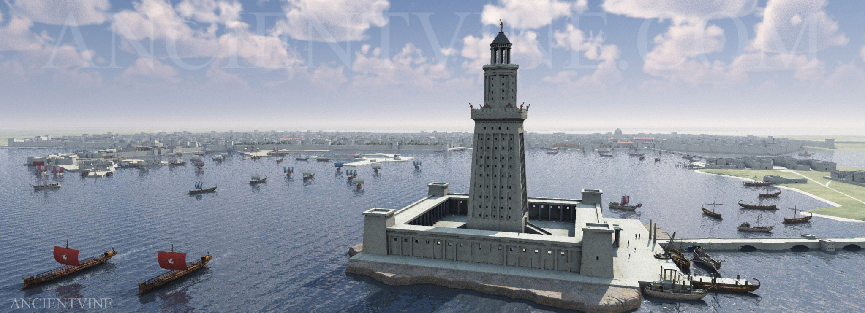
285 Lighthouse built in Alexandria, Egypt
110 metres tall
On the island of Pharos in Alexandria's harbor
A landmark for ships in the eastern Mediterranean

Slide 46
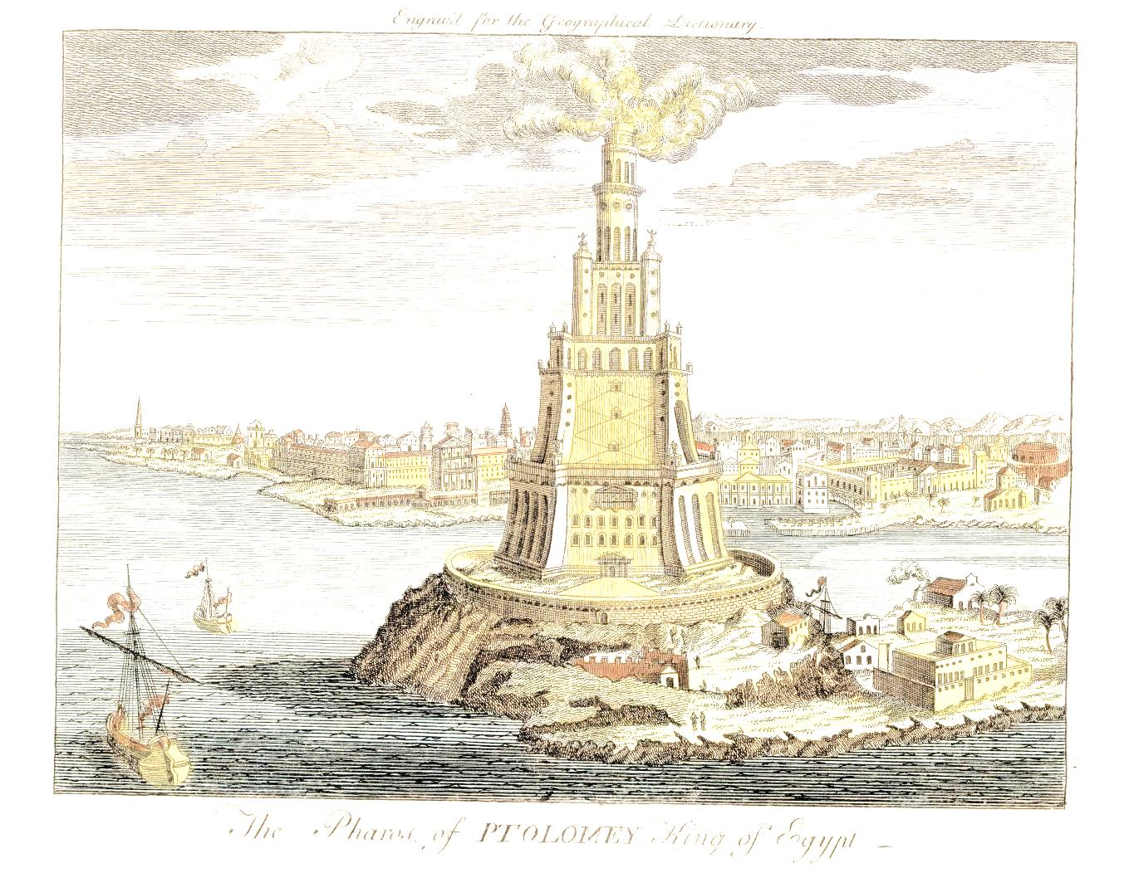
285 Lighthouse built in Alexandria, Egypt
Built by Sostratus of Cnidus for Ptolemy II of Egypt
One of the seven wonders of the ancient world
A technological triumph
Archetype of all lighthouses since
A broad spiral ramp leads to the top, where a fire burns at night

Slide 47
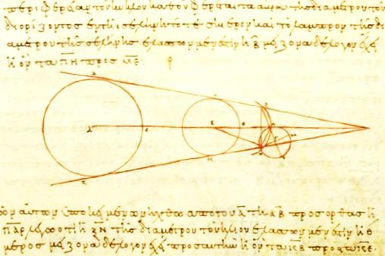
280 Aristarchus of Samos
Uses the size of the Earth's shadow on the Moon to estimate that the Moon's radius
Says the moon’s radius is one-third that of the Earth
Proposes for the first time a heliocentric view of the Solar System
Is ignored due to the lack of evidence of the Earth's motion

Slide 49
273 Rome and Egypt begin a friendship
Rome has just defeated Pyrrhus
Greek general, ruling Macedon at the time
Ptolemy II of Egypt is impressed
Ptolemy II sends an ambassador with good wishes
The visit is reciprocated
= the Romans send back friendly ambassadors
This friendship between Rome and Greek Egypt will make Egypt Roman in 240 years

Slide 50
272 Rome dominates Italian peninsula
Pyrrhus had departed from southern Italy three years earlier
The Samnites are finally conquered by the Romans
Tarentum surrenders
The cities of Magna Graecia in southern Italy come under Roman influence and become Roman allies
Remember, “Magna Graecia” is a Roman term for the Greek colonies founded in the Archaic Age on the Italian peninsula
Rome now effectively dominates all of the Italian peninsula

