Slide 1
THE FIVE GOOD EMPERORS of the Roman empire
The “five good emperors,” as they are usually called, were Nerva, Trajan, and Hadrian (who were related to one another only by adoption), and the two Antonines, Antoninus Pius and Marcus Aurelius. The period of general prosperity which began under Vespasian continued under these emperors. It is during this time that we are able to see Roman civilization at its best, its highest stage of development.

Slide 2
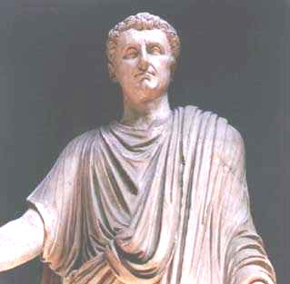
NERVA (A.D. 96-98)
Nerva was chosen neither by the praetorians nor by the legions, but by the senate. Within the brief time that he sat upon the throne, he could do little except to remedy the wrongs of his predecessor.

Slide 3
Nerva (A.D. 96-98)
He forbade the practice of delation, recalled the exiles of Domitian, relieved the people from some oppressive taxes and was tolerant to the Christians. His wise and just reign is praised by all ancient writers. In order to prevent any trouble at his death, he adopted Trajan as his successor and gave him a share in the government.

Slide 4
Nerva (A.D. 96-98)
One of the characteristic features of Nerva’ s short reign was his attempt to relieve the poor. In the first place, he bought up large lots of land from the wealthy landlords, and let them out to the needy citizens. It is noteworthy that he submitted this law to the assembly of the people.

Slide 5
Nerva (A.D. 96-98)
In the next place, he showed his great interest in the cause of public education. He set apart a certain fund, the interest of which was used to educate the children of poor parents. This interest in providing for the care and education of the poorer classes was continued by his successors.

Slide 6
Nerva (A.D. 96-98)
Education among the Romans, though not usually endowed by the state, was very general and was highly appreciated. Its main features were derived from the Greeks. It was intended to develop all the mental powers, and to train a man for public life. Children—both boys and girls—began to attend school at six or seven years of age.

Slide 7
Nerva (A.D. 96-98)
The elementary studies were reading, writing, and arithmetic
The higher education comprised what were called the liberal arts (artes liberales), including the Latin and Greek languages, composition and oratory, and mental and moral philosophy. An important part of education consisted in public recitals and declamations, which were intended to train young men for the forum, and which were often held in the temples.

Slide 8
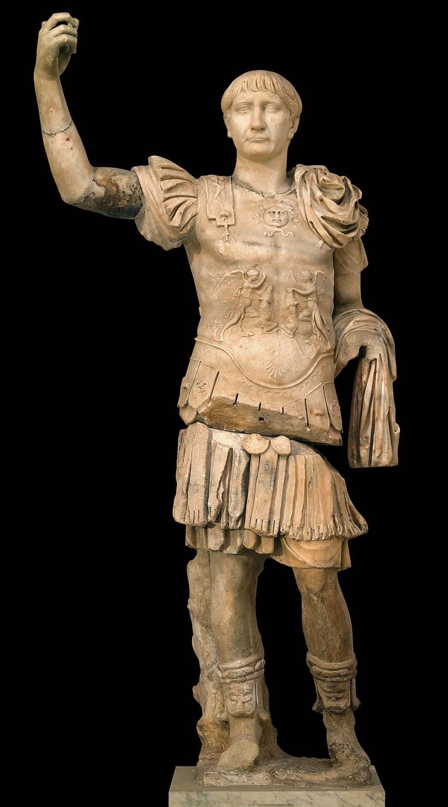
TRAJAN (A.D. 98-117)
Adopted by Nerva, he was accepted by the senate. He made himself popular with the army and with the great body of the people. He was a Spaniard by birth; and the fact that he was the first emperor who was not a native of Italy, shows that the distinction between Romans and provincials was passing away.

Slide 9
TRAJAN (A.D. 98-117)
He was a brave general, a wise statesman, and a successful administrator. He continued the efforts of Nerva to remedy the evils which the early despotism had brought upon Rome. To the people he restored the elective power; to the senate, liberty of speech and of action; to the magistrates, their former authority. He abolished the law of treason (lex maiestatis), and assumed his proper place as the chief magistrate of the empire.

Slide 10
TRAJAN (A.D. 98-117)
He was a generous patron of literature and of art. He also desired to relieve the condition of the poor. It is said that five thousand children received from him their daily allowance of food. So highly was Trajan esteemed by the Romans that to his other imperial titles was added that of “Optimus” (the Best).

Slide 11
TRAJAN (A.D. 98-117) The Conquests of Trajan
Since the death of Augustus there had been made no important additions to the Roman territory, except Britain. But under Trajan the Romans became once more a conquering people. The new emperor carried his conquests across the Danube and acquired the province of Dacia. He then extended his arms into Asia, and brought into subjection Armenia, Mesopotamia, and Assyria, as the result of a short war with the Parthians. Under Trajan the boundaries of the empire reached their greatest extent.

Slide 12
TRAJAN (A.D. 98-117) His Public Works and Buildings.
Rome and Italy and the provinces all received the benefit of his wise administration; and the empire reached its highest point of material grandeur. Roads were constructed for the aid of the provincials. He restored the harbors of Italy, and improved the water supply of Rome. He built two new baths, one of which was for the exclusive use of women. The greatest monument of Trajan was the new Forum, in which a splendid column was erected to commemorate his victories.

Slide 13
TRAJAN (A.D. 98-117) Roman Art
During this period Roman art reached its highest development. The art of the Romans, as we have before noticed, was modeled in great part after that of the Greeks. While lacking the fine sense of beauty which the Greeks possessed, the Romans yet expressed in a remarkable degree the ideas of massive strength and of imposing dignity

Slide 14
TRAJAN (A.D. 98-117) Roman Architecture (We will have a whole lesson on this)
But it was in architecture that the Romans excelled; and by their splendid works they have taken rank among the world’s greatest builders. We have already seen the progress made during the later Republic and under Augustus. With Trajan, Rome became a city of magnificent public buildings. The architectural center of the city was the Roman Forum, with the additional Forums of Julius, Augustus, Vespasian, Nerva, and Trajan. Surrounding these were the temples, the basilicas or halls of justice, porticoes, and other public buildings.

Slide 15
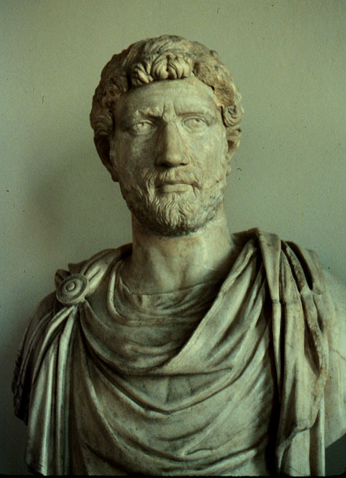
HADRIAN (A.D. 117-138)
At the death of Trajan, his adopted son Hadrian was proclaimed by the praetorian guards. But Hadrian did not regard this as a constitutional act; and he requested to be formally elected by the senate

Slide 16
HADRIAN (A.D. 117-138)
In some respects he was similar to Trajan, with the same generous spirit and desire for the welfare of the people, and with the same wish to add to the architectural splendor of Rome. He was, like Trajan, a friend of literature and a patron of the fine arts, But he differed from Trajan in not thinking that the greatness of Rome depended upon military glory. He believed that the army should be maintained; but that foreign conquest was less important than the prosperity of his subjects.

Slide 17
HADRIAN (A.D. 117-138)
In some respects he was similar to Trajan, with the same generous spirit and desire for the welfare of the people, and with the same wish to add to the architectural splendor of Rome. He was, like Trajan, a friend of literature and a patron of the fine arts, But he differed from Trajan in not thinking that the greatness of Rome depended upon military glory. He believed that the army should be maintained; but that foreign conquest was less important than the prosperity of his subjects.

Slide 18
HADRIAN (A.D. 117-138)
In his political ideas and administrative ability he was a type of the true statesman. He is said to have been a man of wider acquirements and greater general capacity than any previous ruler since Julius Caesar. He was in the best sense liberal and cosmopolitan. He was tolerant of the Christians, and put himself in sympathy with the various races and creeds which made up the empire. Against the Jews only, who rose in revolt during his reign, did he show a spirit of unreasonable severity.

Slide 19
HADRIAN (A.D. 117-138)
Hadrian did not believe that the mission of Rome was to conquer the world, but to civilize her own subjects. He therefore voluntarily gave up the extensive conquests of Trajan in the East, the provinces of Armenia, Mesopotamia, an Assyria. He declared that the Eastern policy of Trajan was a great mistake. He openly professed to cling to the policy of Augustus, which was to improve the empire rather than to enlarge it.

Slide 20
HADRIAN (A.D. 117-138)
The Imperial Council (consilium principis)
Another evidence of the statesmanship of Hadrian is seen in the fact that he was willing, to take advice. He paid great deference to the senate; and the body of imperial counselors (consilium principis), which had been occasionally consulted by the previous emperors, became from his time a permanent institution.
The emperor was not now the victim of unworthy advisers, as in the time of Tiberius, but was surrounded by men noted for their learning and wisdom. These men were often trained lawyers, who were skilled in the rules of justice.

Slide 21
HADRIAN (A.D. 117-138)
The Perpetual Edict of Salvius Julianus
(Edictum Perpetuum)
That ancient code was framed upon the customs of a primitive people. It did not represent the actual law by which justice was now administered. A new and better law had grown up in the courts of the praetors and of the provincial governors. It had been expressed in the edicts of these magistrates; but it had now become voluminous and scattered. Hadrian delegated to one of his jurists, Salvius Julianus, the task of collecting this law into a concise form, so that it could be used for the better a ministration of justice throughout the empire.

Slide 22
HADRIAN (A.D. 117-138)
Hadrian showed a stronger sympathy with the provinces than any of his predecessors, and under his reign the provincials attained a high degree of prosperity and happiness. He conducted himself as a true sovereign and friend of his people. To become acquainted with their condition and to remedy their evils, he spent a large part of his time in visiting the provinces. Of his long reign of twenty-one years, he spent more than two thirds outside of Italy.

Slide 23
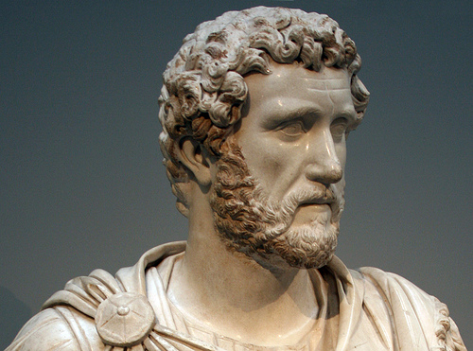
ANTONINUS PIUS (A.D. 138-161)
If we desired to find in Roman history a more noble character than that of Hadrian, we should perhaps find it in his adopted son and successor, Antoninus, surnamed Pius.

Slide 24
ANTONINUS PIUS (A.D. 138-161)
The description given of him by his son, Marcus Aurelius, is worthy to be read by the young people of all times.
“In my father,” he says, “I saw mildness of manners, firmness of resolution, contempt of vain glory. He knew when to rest as well as to labor. He taught me to forbear from all improper indulgences, to conduct myself as an equal among equals, to lay on my friends no burden of servility. From him I learned to be resigned to every fortune and to bear myself calmly and serenely; to rise superior to vulgar applause, and to despise vulgar criticism; to worship the gods without superstition and to serve mankind without ambition. He was ever prudent and moderate; he looked to his duty only, and not to the opinions that might be formed of him. Such was the character of his life and manners—nothing harsh, nothing excessive, nothing rude, nothing which showed roughness and violence.”

Slide 25
ANTONINUS PIUS (A.D. 138-161)
The “Reign without Events.”
The reign of Antoninus, although a long one of twenty-three years, is known in history as the uneventful reign. Since much that is usually called “eventful” in history is made up of wars, tumults, calamities, and discords, it is to the greatest credit of Antoninus that his reign is called uneventful. We read of no conquests, no insurrections, no proscriptions, no extortions, no cruelty. His reign is an illustration of the maxim, “Happy is the people which has no history.” Although not so great a statesman as Hadrian, he yet maintained the empire in a state of peace and prosperity. He managed the finances with skill and economy. He was kind to his subjects; and interfered to prevent the persecution of the Christians at Athens and Thessalonica.

Slide 26
ANTONINUS PIUS (A.D. 138-161)
It was during the period of the Antonines that the imperial government reached its highest development. This government was, in fact, the most remarkable example that the world has ever seen of what we may call a “paternal autocracy”—that is government in the hands of a single ruler, but exercised solely for the benefit of the people. In this respect the ideals of Julius and Augustus seem to have been completely realized.

Slide 27
ANTONINUS PIUS (A.D. 138-161)
The emperor was looked upon as the embodiment of the state, the personification of law, and the promoter of justice, equality, and domestic peace. Every department of the administration was under his control. He had the selection of the officials to carry into execution his will. The character of such a government the Romans well expressed in their maxim, “What is pleasing to the prince has the force of law.”

Slide 28
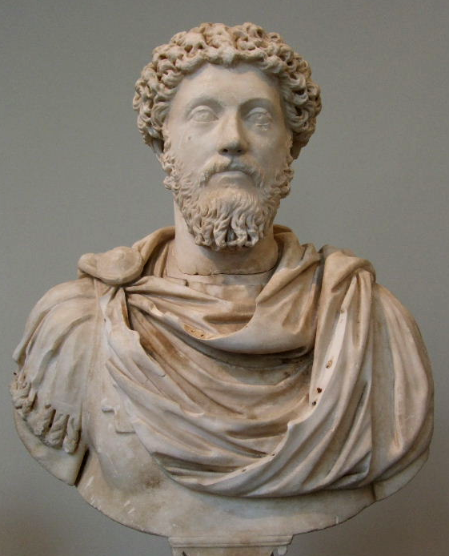
MARCUS AURELIUS (A.D. 161-180)
Philosopher on the Throne- Marcus Aurelius was the adopted son of Antoninus Pius, and came to the throne at his father’s death. The new emperor was first of all a philosopher. He had studied in the school of the Stoics, and was himself the highest embodiment of their principles. He was wise brave, just, and temperate

Slide 29
MARCUS AURELIUS (A.D. 161-180)
The history of the pagan world presents no higher example of uprightness and manhood. In whatever he did he acted from a pure sense of duty. But his character as a man was no doubt greater than his ability as a statesman. So far as we know, Marcus Aurelius never shrank from a known duty, private or public; but it is not so clear that his sense of personal duty was always in harmony with the best interests of the empire.

Slide 30
MARCUS AURELIUS (A.D. 161-180)
Misfortunes of his Reign.
In judging of this great man we must not forget that his reign was a time of great misfortunes. Rome was afflicted by a deadly plague and famine, the most terrible in her history. From the East it spread over the provinces, carrying with it death and desolation. One writer affirms, with perhaps some exaggeration, that half the population of the empire perished. The fierce barbarians of the north were also trying to break through the frontiers, and threatening to overrun the provinces. But Marcus Aurelius met all these dangers and difficulties with courage and patience.

Slide 31
MARCUS AURELIUS (A.D. 161-180)
His Persecution of the Christians.—The most striking example of the fact that the emperor’s sense of duty was not always in harmony with the highest welfare of the people is shown in his persecution of the Christians. The new religion had found its way throughout the eastern and western provinces. It was at first received by the common people in the cities.

Slide 32
MARCUS AURELIUS (A.D. 161-180)
Since the time of Nero, the policy of the rulers toward the new sect had varied. But the best of the emperors had hitherto been cautious like Trajan, or tolerant like Hadrian, or openly friendly like Antoninus. But Marcus Aurelius sincerely believed that the Christians were the cause of the popular tumults, and that the new sect was dangerous to the public peace. He therefore issued an order that those who denied their faith should be let alone, but those who confessed should be put to death.

Slide 33
MARCUS AURELIUS (A.D. 161-180)
Roman Philosophy.—Marcus Aurelius expressed in his life and writings the highest ideas of Roman philosophy. The Romans cannot, however, be said to have shown any originality in their philosophical systems. These they derived almost entirely from the Greeks. The two systems which were most popular with them were Epicureanism and Stoicism. The Epicureans believed that happiness was the great end of life. But the high idea of happiness advocated by the Greek philosophers became degraded into the selfish idea of pleasure, which could easily excuse almost any form of indulgence. In Rome we see this idea of life exercising its influence especially upon the wealthy and indolent classes.

Slide 34
MARCUS AURELIUS (A.D. 161-180)
Roman Philosophy.—Marcus Aurelius expressed in his life and writings the highest ideas of Roman philosophy. The Romans cannot, however, be said to have shown any originality in their philosophical systems. These they derived almost entirely from the Greeks. The two systems which were most popular with them were Epicureanism and Stoicism. The Epicureans believed that happiness was the great end of life. But the high idea of happiness advocated by the Greek philosophers became degraded into the selfish idea of pleasure, which could easily excuse almost any form of indulgence. In Rome we see this idea of life exercising its influence especially upon the wealthy and indolent classes.

Slide 35
MARCUS AURELIUS (A.D. 161-180)
The Stoics, on the other hand, believed that the end of life was to live according to the highest law of our nature. This doctrine tended to make strong and upright characters. It could not well have a degrading influence; so we find some of the noblest men of Rome adhering to its tenets—such men as Cato, Cicero, Seneca, and Marcus Aurelius. The Stoic philosophy also exercised a great and beneficial influence upon the Roman jurists, who believed that the law of the state should be in harmony with the higher law of justice and equity.

Slide 36
Outlines of Roman History by William C. Morey, Ph.D., D.C.L. New York, Cincinnati, Chicago: American Book Company (1901).

