Slide 1
The Germanic Tribes
The Fall of Rome
Information taken from an article by F. Roy Willis Professor of History at the University of California
F. Roy Willis, Professor of History University of California
Robert A. Guisepi, Historian and Editor

Slide 2
The Decline of Rome
Upon the decline of Roman imperial power, Germanic tribes from the east took over vast lands once ruled from Rome. After long period of growth, development and sometimes darkness, the barbarian came of age. Armed with a religion from the Mid-East, Roman law and governmental organization, Greek art and philosophy, the descendants of these barbarians would spread their culture all over the globe. Yet, for all the great art, music, philosophy and egalitarian writings about the rights of Man, there is a deep strain of violence which has permeated Western Civilization and it has existed from the birth of the West.

Slide 3
The Decline of Rome
Only the West has made war on such a grand scale...all over the world and with a destructiveness unmatched by any other people. It is only recently that the West has managed to refrain from total war. It was born from war, has lived and thrived by war yet in order to survive, it must now abandon total war.

Slide 4
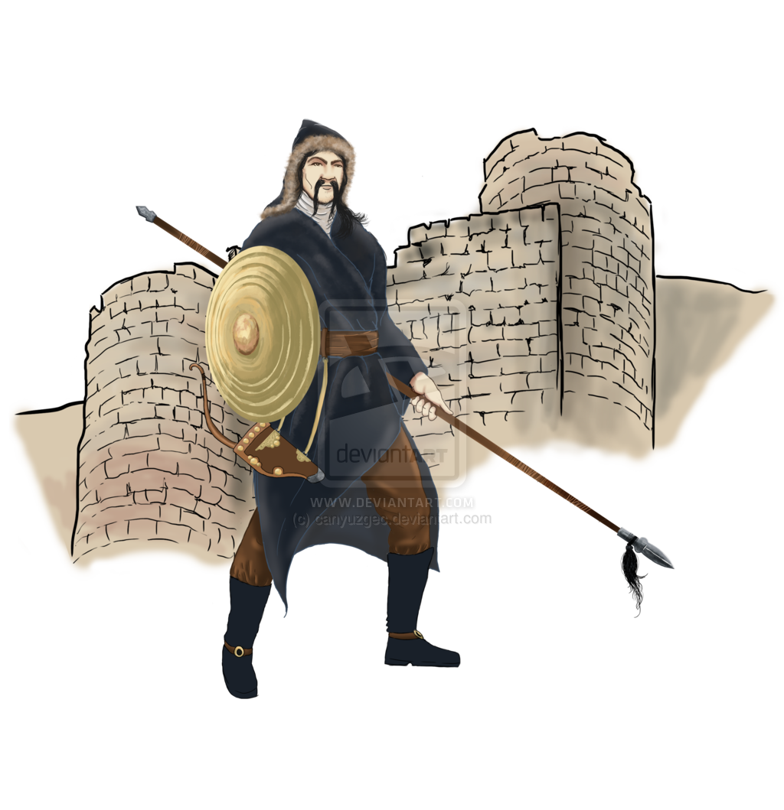
The Huns
The Huns, who had set in motion this vast movement of peoples, moved westward from the center they had established on the plains of Hungary . Both Romans and Germans were terrified of these savage warriors whose only interest was plunder and bloodshed. Joining momentarily together in 451, the Romans and Visigoths defeated the Hun leader, Attila, at the battle of Chalons; and within a couple of years the Huns had withdrawn from Europe . Their disappearance, however, only facilitated the entry into the empire of several more Germanic tribes: the Ostrogoths, the Franks, and the Anglo-Saxons.

Slide 5
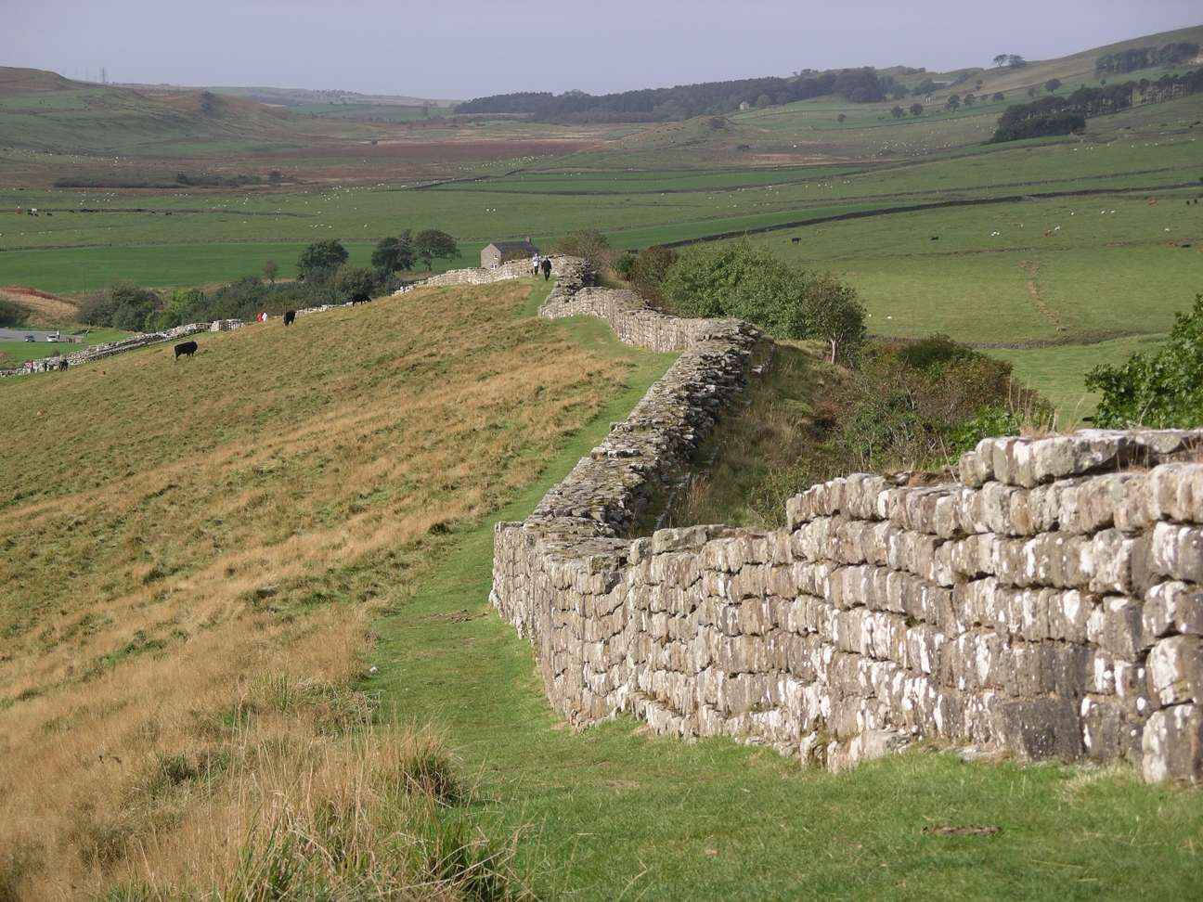
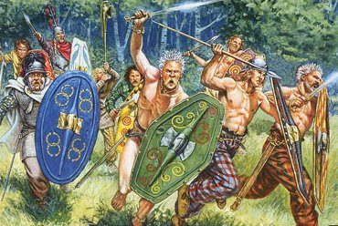
Hadrian’s Wall and the Celts
The purpose of the great defense walls of the Roman Empire , the limes that ran across central Germany , Hadrian's Wall in England , and the fortifications along the Danube , and also of most campaigns fought in Europe from the time of Augustus had been to protect the area of "civilization" within the empire from the "barbarians" outside. In Scotland and Ireland , the barbarians were Celtic, an artistic, warlike, and highly emotional people, who for several centuries had been withdrawing ever further northwards to the coastal fringes of northwestern Europe from the lands they had once held, in France and Germany .

Slide 6
The Germanic Tribes
On the continent between the Rhine-Danube frontier, Scandinavia , and the Black Sea , lived the Germanic tribes. In spite of the danger they represented to the empire, these tall fair-haired warriors, dressed in skins and draped in gold armbands and chains, fascinated the urbanized Romans. Tacitus claimed to see in them a noble simplicity and vigor that had been lost by the effete Roman of his own day. The way of life of all the Germanic tribes, at least before the influence of Rome affected those closest to the empire, was fairly similar. They had begun to give up a nomadic life and to settle in small village communities separated from each other by the forest. Their political institutions were primitive but important for the future

Slide 7
The Germanic Tribes

Slide 8
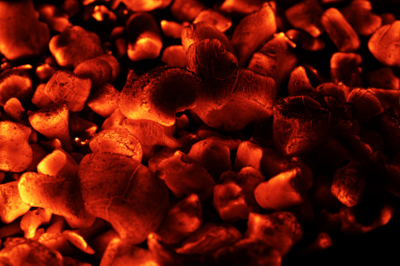
Germanic Tribes Cont.
Law was administered through a tribal court, called a Moot, in which all the warriors of the community judged complaints brought by one member of the tribe against another. The court usually settled the matter either by allowing the defendant to take an oath of innocence provided he was supported by friends who swore to his reliability, or by putting the defendant to ordeal. In this case, he might be made to walk through fire. If he were innocent, his wounds would begin to heal in a few days.

Slide 9
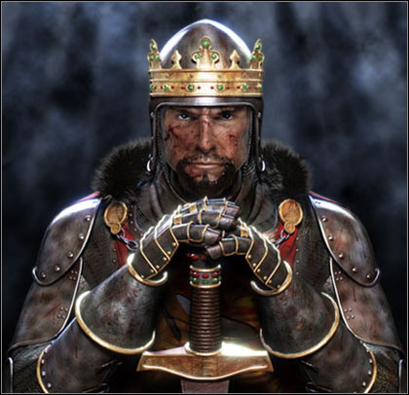
Germanic Tribes Cont.
The chief was chosen by the warriors for his fitness to lead them in war. The warriors in turn swore personal allegiance to the chief, and became members of his “comitatus”, or group of warrior companions. Elective monarchy was thus accompanied by the principle of personal loyalty to one's lord, which became one of the primary social bonds in medieval European society. Beyond these facts, little is known about the German tribes before they began to press again on the weakening Roman Empire in the late fourth century.

Slide 10
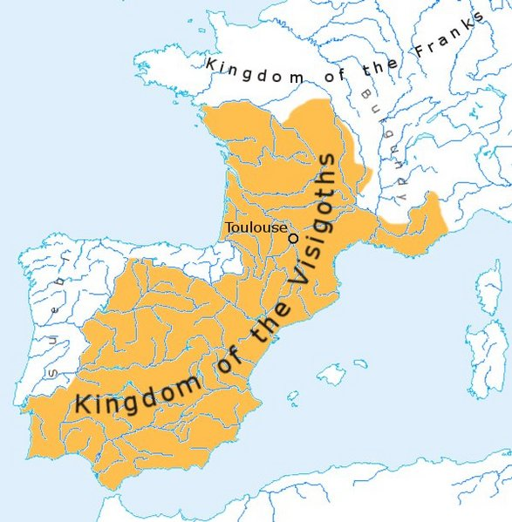
Visigoths
The first Germanic people to penetrate the frontiers of the empire were the West Goths , or Visigoths. The Goths had originally lived in southern Scandinavia and around the Baltic. But moving south in the second century they had split into two groups, the East Goths, or Ostrogoths, who had remained in southern Russia to live off the land as an army of conquerors, and the West Goths, or Visigoths, who drove the Romans out of Dacia (modern Rumania). The Goths were receptive to Roman ways of life, developed a taste for Roman luxuries, and adopted the Arian form of Christianity

Slide 11
Visigoths
Many were recruited into the Roman army, and even took offices of state in Constantinople itself. Thus, when the westward drive of a Mongolian people called the Huns from the steppes of Russia overwhelmed the Ostrogoths, the emperor Valens of Constantinople was not unwilling to permit the Visigoths to move into the empire in 376 to defend its Danube frontier. Apparently outraged at the treatment they had received from imperial officials, the Visigoths took up arms against the emperor, who was defeated and killed at the battle of Adrianople in 378. His successor Theodosius I placated the Visigoths with gifts of land and payment of tribute, and they in return furnished recruits to the imperial army.

Slide 12
Visigoths
Relations with the Visigoths deteriorated after the death of Theodosius I in 395, when the empire was divided again between his two sons, Arcadius (reigned 395-408) who inherited the Eastern Roman Empire and Honorius (reigned 395-423) who inherited the Western Roman Empire. Furious at the conditions of military service imposed on his people, Alaric, the leader of the Visigoths, led his troops against Constantinople in 395, but was persuaded to divert his army into Greece, capturing Athens. Alaric, after declaring himself king of the Visigoths, led them north into Illyricum ( Yugoslavia ). In Italy , Honorius sought seclusion and luxury in the city of Ravenna , which was well protected by broad marshes, leaving his regent, the Vandal soldier Stilicho, to deal with Alaric's invasion of Italy after 403. Stilicho used strategic cunning as well as bribery to keep the Visigoths away from Rome; but, after Stilicho was unjustly executed on charges of treason, Alaric was able to besiege and finally in August 410 to capture and sack Rome.

Slide 13
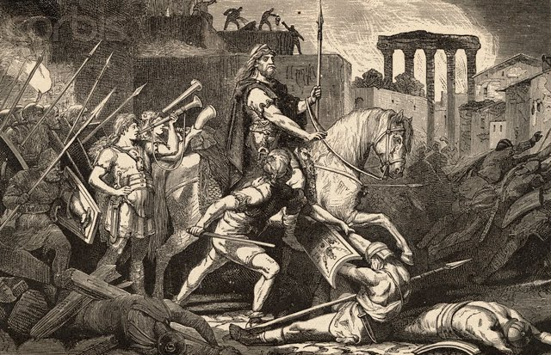
Visigoths
It was eight hundred years since a foreign invader had broken through the walls of Rome . "The world sinks into ruin," wrote St. Jerome . "Yes! but shameful to say our sins still live and flourish. The renowned city, the capital of the Ro- man Empire, is swallowed up in one tremendous fire; and there is no part of the earth where Romans are not in exile." Fortunately, Jerome was exaggerating. Few people were killed; the houses of nobles were plundered. The Forum was set ablaze, but all the churches were spared. Alaric even organized a fine procession to Saint Peter's to present the treasures he had saved for the pope.

Slide 14
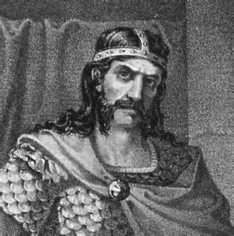
Visigoths
Alaric died shortly afterwards, and a river was temporarily diverted to provide a secure grave for him in its bed. The Visigoths then moved on to southern France and Spain , where they finally settled. Al- though they were tolerant of the Catholic worship in the areas they con- trolled, they were isolated from the Latin population for almost two centuries by their refusal to give up Arianism. They were finally converted toward the end of the sixth century.

Slide 16
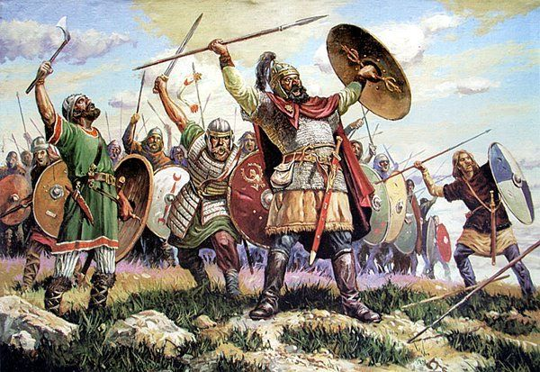
The Vandals
Even before the Goths sacked Rome , another Germanic tribe, the Vandals, had pushed into the empire over the Rhine . Crossing France , they settled for a short while in Spain , from which the Visigoths expelled them.

Slide 17
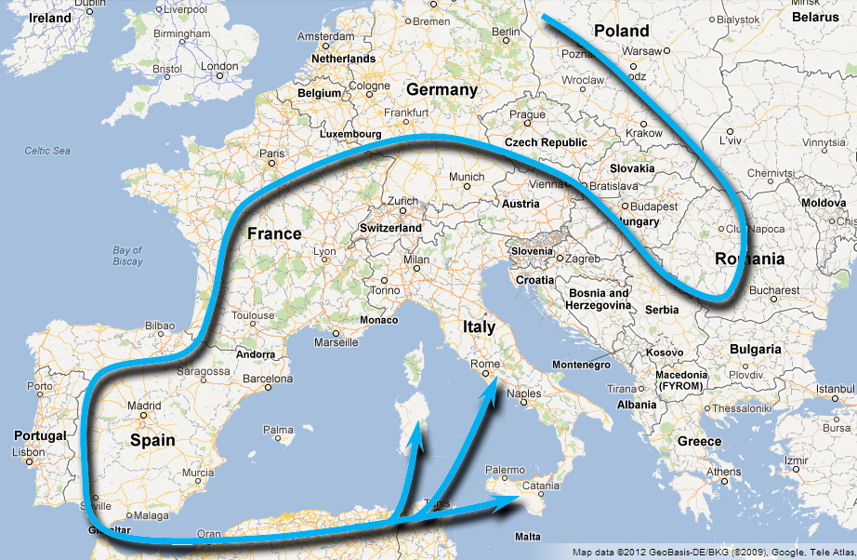
The Vandals
They then crossed the Straits of Gibraltar, conquered the rich province of North Africa, built themselves a fleet, and in 455 sacked Rome with greater thoroughness than the Visigoths. They took the treasures from the emperor's palaces on Palatine hill and even the tile from the roofs of the temples, and returned with their spoil to their new capital of Carthage . As Arian Christians, they persecuted their Catholic subjects, and thus, as a result of internal dissension, were so weakened that they fell easy prey to the armies of the East Roman Emperor Justinian in 533.

Slide 18
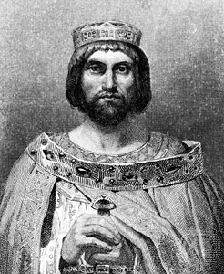
The Ostrogoths
Once they had broken loose from Hun control, the Ostrogoths moved slowly toward northern Italy . Their leader was Theodoric, one of the most talented leaders of all the Germanic peoples. He had spent ten years in Constantinople as a hostage, knew both Latin and Greek, and had developed a profound admiration for the ancient civilization he had been forcibly acquainted with. He had not, however, lost his tribal skills, for after conquering most of northern Italy , he demonstrated his ability with the broad- sword by slicing in two his rival for control of Italy and his ruthlessness by exterminating the rival's family.
Theodoric (Ostrogoth King)

Slide 19
The Ostrogoths
Theodoric then showed more constructive statesmanship. From 493 till his death in 526, he governed Italy and large parts of the Balkans as the regent of the emperor in Constantinople and as King of the Goths, establishing both in title and in actuality a successful policy of racial coexistence. The Goths took one-third of the land and houses and all military duties. The Romans kept the rest, and devoted themselves to peaceful pursuits. Gothic law applied to Goths, Roman law to Romans. Intermarriage was forbidden.
Theodoric (Ostrogoth King)

Slide 20
The Ostrogoths
Although Theodoric was an Arian Christian, he tolerated the Catholic religion and even the Jewish and other faiths. "Religion is not something we can command," he said. "No one can be forced into a faith against his will." He showed great concern for Roman culture. He restored monuments that had fallen into ruin, including the Coliseum in Rome , where circuses were still presented. But it was at the capital of Ravenna that the Ostrogothic king showed the heights of civilization that could be achieved with the fusion of Germanic and Roman skills.

Slide 21
The Ostrogoths
Ravenna had been made the capital of the western part of the Roman Empire because of its excellent harbor and because it was protected by wide marshes. It was a city of islands, canals, bridges, and causeways, looking across lagoons to the Adriatic Sea . Here Theodoric found that the Roman artists had brought to perfection one of the most demanding and un- compromising of all artistic forms, the art of mosaic; and it was for this achievement that his Ravenna would be principally remembered. In mosaic the artist must set enormous numbers of tiny bits of marble, enamel, glass, and colored stone into damp cement. He cannot produce those subtleties of expression possible in an oil painting, but must seek an overall effect usually visible only from a distance. But in return he is able to use the play of light not only upon the many different angles of the tiny mosaic stones but within the mosaic itself.

Slide 22
The Ostrogoths
In Ravenna , the artists were developing new materials for this art, applying gold leaf to glass cubes and covering them again with a thin film of glass, using metallic oxides to produce variations of color, or employing mother of pearl to produce just the right effect of creamy perfection. In the windows, they often used thick sheets of alabaster, so that the entering light already had a soft opacity before playing upon the planes of yellow marble and the complexity of the mosaic surface. In Ravenna, they constructed buildings as though they were galleries meant to display mosaics, with bare wafls designed to permit the artist to create the largest, most complex compositions yet attempted in that exacting form of art. One last advantage is still evident today; the process is almost permanent. Unlike frescoes, which fade fairly rapidly, many of the mosaics in Ravenna have required no restoration, and shine as brightly today as in the sixth century.

Slide 23
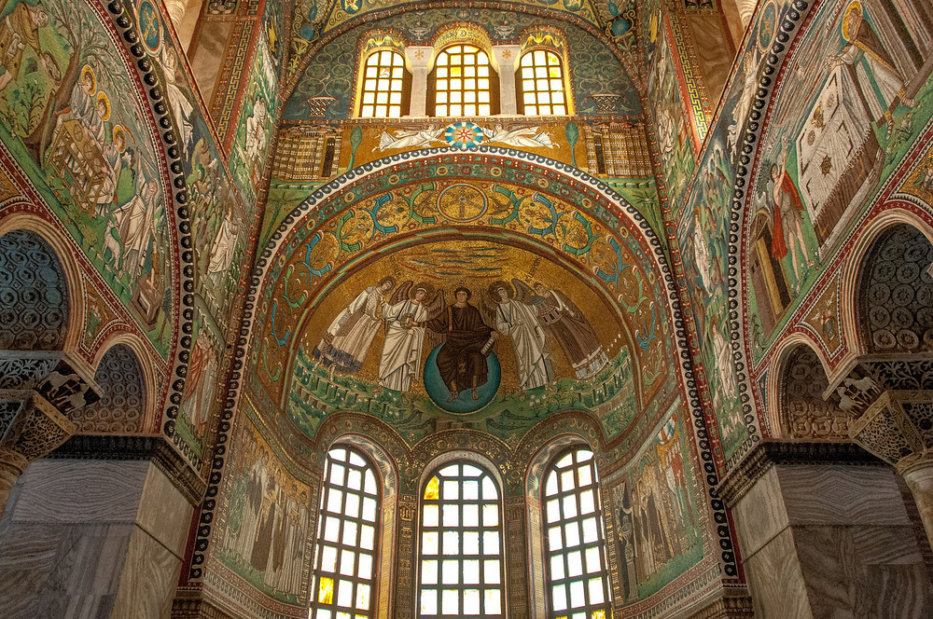
The Ostrogoths

Slide 24
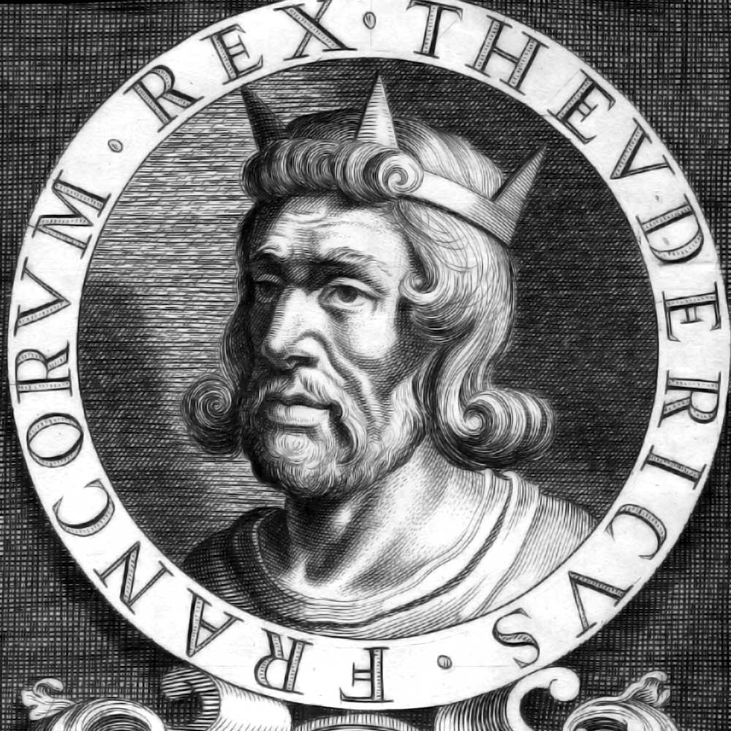
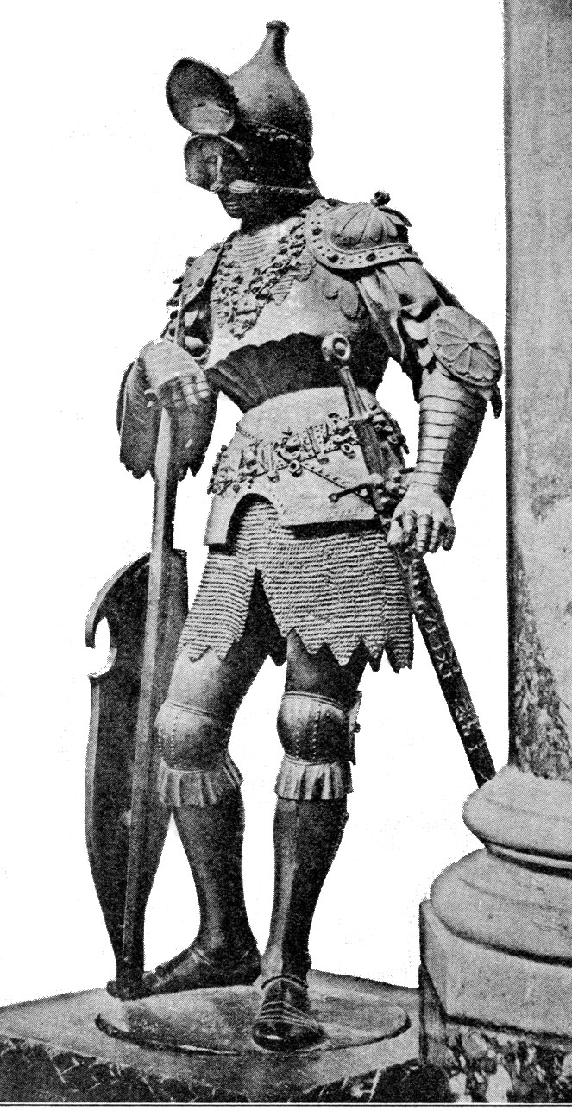
The Ostrogoths
Theodoric died in 526. His successors lacked his skills, and in less than forty years, the Ostrogoths were driven from Italy by the army of the Eastern Roman emperor; they moved north of the Alps , and rather surprisingly disappeared from history. Thus, the Visigoths, the Ostrogoths, and the Vandals, who were largely responsible for the disappearance of the Roman Empire in the West, left little lasting trace. The Franks and the Anglo- Saxons, however, were to become the principal creators of medieval civilization.

Slide 25
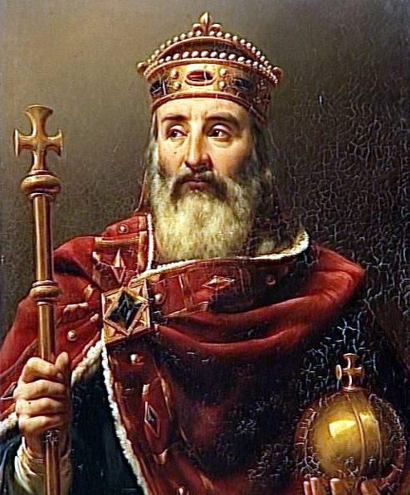
The Franks
The Franks lived between the North Sea and the upper Rhine , and they never gave up this territory but expanded from it both westward and east- ward. Most of France was in the hands of the Visigoths and another Germanic tribe, the Burgundians, when the Franks began their conquests in the fifth century. Under their powerful king, Clovis (reigned 481-511), they defeated both the Visigoths and the Burgundians, and established control over most of modern France .

Slide 26
The Franks
The crucial event in the reign of Clovis occurred in 496, during one of his many battles. Apparently influenced by his wife, who was Catholic, Clovis promised to give up his paganism and to become Christian if he were victorious. He kept his promise, and took three thousand of his warriors with him to be baptized in the local shrine. By his con- version to Catholicism, Clovis accepted the ecclesiastical structure of Gaul based upon the original Roman administration, won the alliance of the Catholic clergy, and took for the Frankish armies the task of crusader against non-Catholic barbarians. At the same time, he made possible the intermingling of the Germanic tribesmen with the original Romanized population of France . Once the religious barrier was removed, intermarriage was permitted. The Germanic language slowly gave way to the rough Latin that was to turn gradually into French. The constitutional ideas of Romans and Germans were combined, usually to the benefit of the absolutism of the Germanic kings.

Slide 27
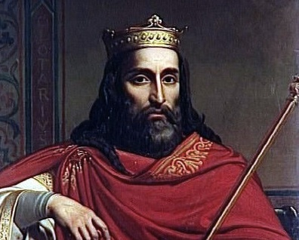
The Franks
Roman agricultural practices were taken up by the Germans, who contributed their ability to open up the heavy clay soils that appeared once the forests had been cleared. What distinguished the Frankish kingdom was not the height of its culture. Clovis was no Theodoric, and his capital city of Paris was no Ravenna . The Franks were creating a new people whose culture would be a genuine fusion of Roman and Germanic elements.

Slide 28
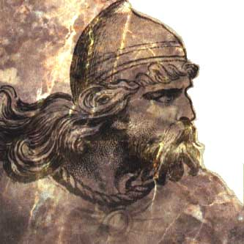
The Anglo-Saxons
Whereas in France , the original Romanized inhabitants vastly outnumbered the invading Franks, in England the Germanic invaders, the Angles, Saxons, and Jutes from northern Germany and Denmark , drove most of the original Celtic inhabitants to Cornwall , Wales , and Scotland in the far western regions of the British Isles . The invaders, whom for convenience we call the Anglo-Saxons, ignored most of the Roman achievements they found. They disliked the land already being farmed, which was mostly light chalky soil on the hilltops, and preferred the clay lands of the river valleys. They paid no attention to Roman law, but introduced a wholly Germanic tribal system of government.

Slide 29
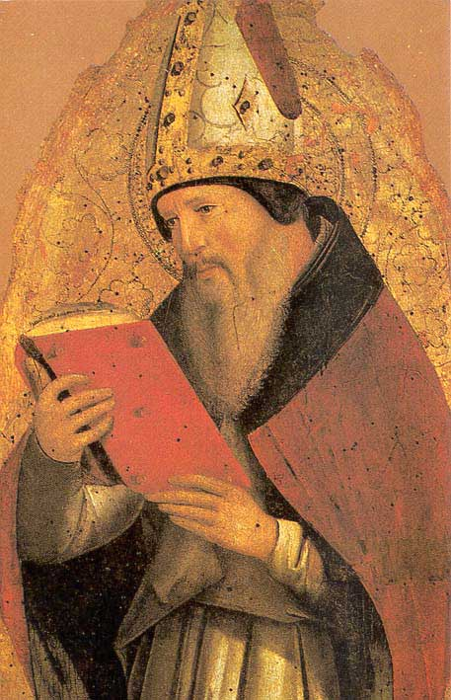
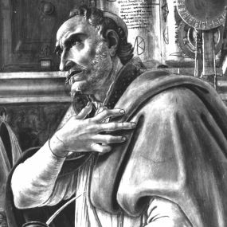
The Anglo-Saxons
They arrived as pagans, and were converted only at the end of the sixth century by St. Augustine 's mission sent directly from Rome . The Anglo-Saxons thus received what Romanization they had from the Catholic Church. From the Roman Empire itself, they acquired only the roads. By contrast even with Clovis 's Paris , life in Anglo-Saxon England was rough, drab, and dangerous.

Slide 30
Conclusion
Under the impact of these Germanic invaders, the control of the Roman Empire in Western Europe disappeared. The last emperor in the West was the boy ruler Romulus Augustulus, who was killed in 476 by the Germanic chieftain Odoacer. Odoacer however did not declare that he had put an end to the Roman Empire in the West. He sent the insignia of the emperor back to Constantinople with the message that the empire needed only one emperor, and that he would act as the representative of Constantinople in Italy . Odoacer felt, in short, that he had reunited the Roman Empire . However, the Roman Empire in the West had fallen. Britain , France , the Low Countries , Spain , north Africa, and Italy itself were all in the hands of Ger- manic invaders, whether or not those invaders paid lip service to the emperor in faraway Constantinople

