Slide 1
Bellwork
We see Athens rising to a great place of power. They feel as if they deserve it for their actions in the Persian War. Which may or may not be the case. You decide. Then back up your decision with either evidence or a well thought out argument. Be ready to defend yourself.

Slide 2
The First Peloponnesian War
The First Peloponnesian War (460 BC - c. 445 BC) was fought between Sparta as the leaders of the Peloponnesian League and Sparta's other allies, most notably Thebes, and the Delian League led by Athens with support from Argos.
There were several causes for the war including the building of the Athenian long walls, Megara's defection and the envy and concern felt by Sparta at the growth of the Athenian Empire

Slide 3
The Long Walls
in Ancient Greece, were walls built from a city to its port, providing a secure connection to the sea even during times of siege. Although long walls were built at several locations in Greece—Corinth and Megara being two of the best known example
the phrase "long walls" generally refers to the walls connecting Athens to its ports at Piraeus and Phalerum.

Slide 4
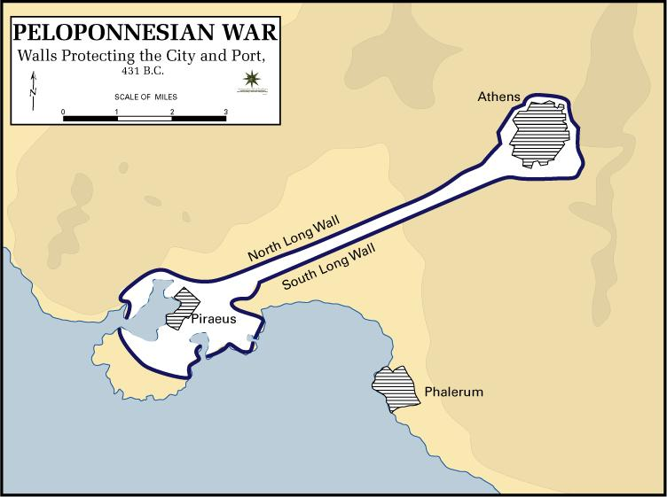

Slide 5
They were a key element of Athenian strategy, since they provided the city with a constant link to the sea and prevented it from being besieged by land alone.

Slide 6
The original walls of Athens had been destroyed by the Persians during the occupations of Attica in 480 and 479 BC, part of the Greco-Persian Wars. After the Battle of Plataea, the Persian forces that had invaded Greece in 480 BC were safely removed, and the Athenians were free to reoccupy their land and begin rebuilding their city.
Early in the process of rebuilding, construction was started on new walls around the city proper. This project drew opposition from the Spartans and their Peloponnesian allies, who had been alarmed by the recent increase in the power of Athens.

Slide 7
Spartan envoys urged the Athenians not to go through with the construction, arguing that a walled Athens would be a useful base for an invading army, and that the defenses of the isthmus of Corinth would provide a sufficient shield against invaders; however, despite these concerns the envoys did not strongly protest and did in fact give advice to the builders.
The Athenians disregarded the arguments, fully aware that leaving their city unwalled would place them utterly at the mercy of the Peloponnesians; Thucydides, in his account of these events, describes a series of complex machinations by Themistocles by which he distracted and delayed the Spartans until the walls had been built up to such a height as to be defensible.

Slide 8
In the early 450s BC, fighting began between Athens and various Peloponnesian allies of Sparta, particularly Corinth and Aegina. In the midst of this fighting, Athens had begun construction of two more walls between 462 BC and 458 BC, one running from the city to the old port at Phalerum, the other to the newer port at Piraeus.
In 457 BC, a Spartan army defeated an Athenian army at Tanagra while attempting to prevent the construction, but work on the walls continued, and they were completed soon after the battle. These new walls, the Long Walls, ensured that Athens would never be cut off from supplies as long as she controlled the sea.

Slide 9
Bellwork
“When one is deprived of ones liberty, one is right in blaming not so much the man who puts the shackles on as the one who had the power to prevent him, but did not use it.”
― Thucydides, History of the Peloponnesian War
Who is more to blame? The man with the shackle on? Or the one who put him in shackles?

Slide 10
First Peloponnesian War Cont
The war began in 460 BC (Battle of Oenoe). At first the Athenians had the better of the fighting, winning the naval engagements using their superior fleet. They also had the better of the fighting on land, until 457 BC when the Spartans and their allies defeated the Athenian army at Tanagra.
The Athenians, however, counterattacked and scored a crushing victory over the Boeotians at the Battle of Oenophyta and followed this victory up by conquering all of Boeotia except for Thebes.

Slide 11
Athens further consolidated their position by making Aegina a member of the Delian League and by ravaging the Peloponnese.
The Athenians were defeated in 454 BC by the Macedonians which caused them to enter into a five years' truce with Sparta. However, the war flared up again in 448 BC with the start of the Second Sacred War. In 446 BC, Boeotia revolted and defeated the Athenians at Coronea and regained their independence

Slide 12
The Thirty Year Treaty: 446-431 BC
The Thirty Years' Peace was a treaty, signed between the ancient Greek city-states Athens and Sparta, in the year 446/445 BC.
The treaty brought an end to the conflict commonly known as the First Peloponnesian War, which had been raging since c.460 BC.

Slide 13
The Thirty Year Treaty
The purpose of the treaty was to prevent another outbreak of war. Ultimately, the peace treaty failed in achieving its goal. Athens was forced to give up all of her possessions in the Peloponnese w

Slide 14
The Thirty Year Treaty
This also ruled out armed conflict between Sparta and Athens if at least one of the two wanted arbitration. Neutral poleis could join either side (i.e. Sparta or Athens and this implies that there was a formalized list of allies for each side. Athens and Sparta would keep all other territories pending arbitration. It also recognized both Leagues as legitimate, a boost for Athens and its newly formed empire in the Aegean.

Slide 15
The Thirty Year Treaty
The peace lasted only 13 years. It ended with Sparta declaring war with Athens. During the peace treaty Athens took steps to undermined the truce.
They joined in a dispute between Epidermis and Corcyra in 435 BC. This angered the Corinthians who are an ally of Sparta.
In 432 BC. Athens attacked Potidaea, which was an ally of Athens, but a Corinthian colony.

Slide 16
All of this prompted the Spartans to declare that the Athenians have violated the treaty, thus declaring war. At this point the Thirty Year’s Peace was void and the second Peloponnesian War began. (which we simply call The Peloponnesian War.)

